Slide 1
Whether the weather be wet Or whether the weather be hot We’ll weather the weather Whatever the weather Whether we like it or not!
Anonymous
(I’m Andrew Trotman)

Slide 2
Christmas 2013

Slide 3
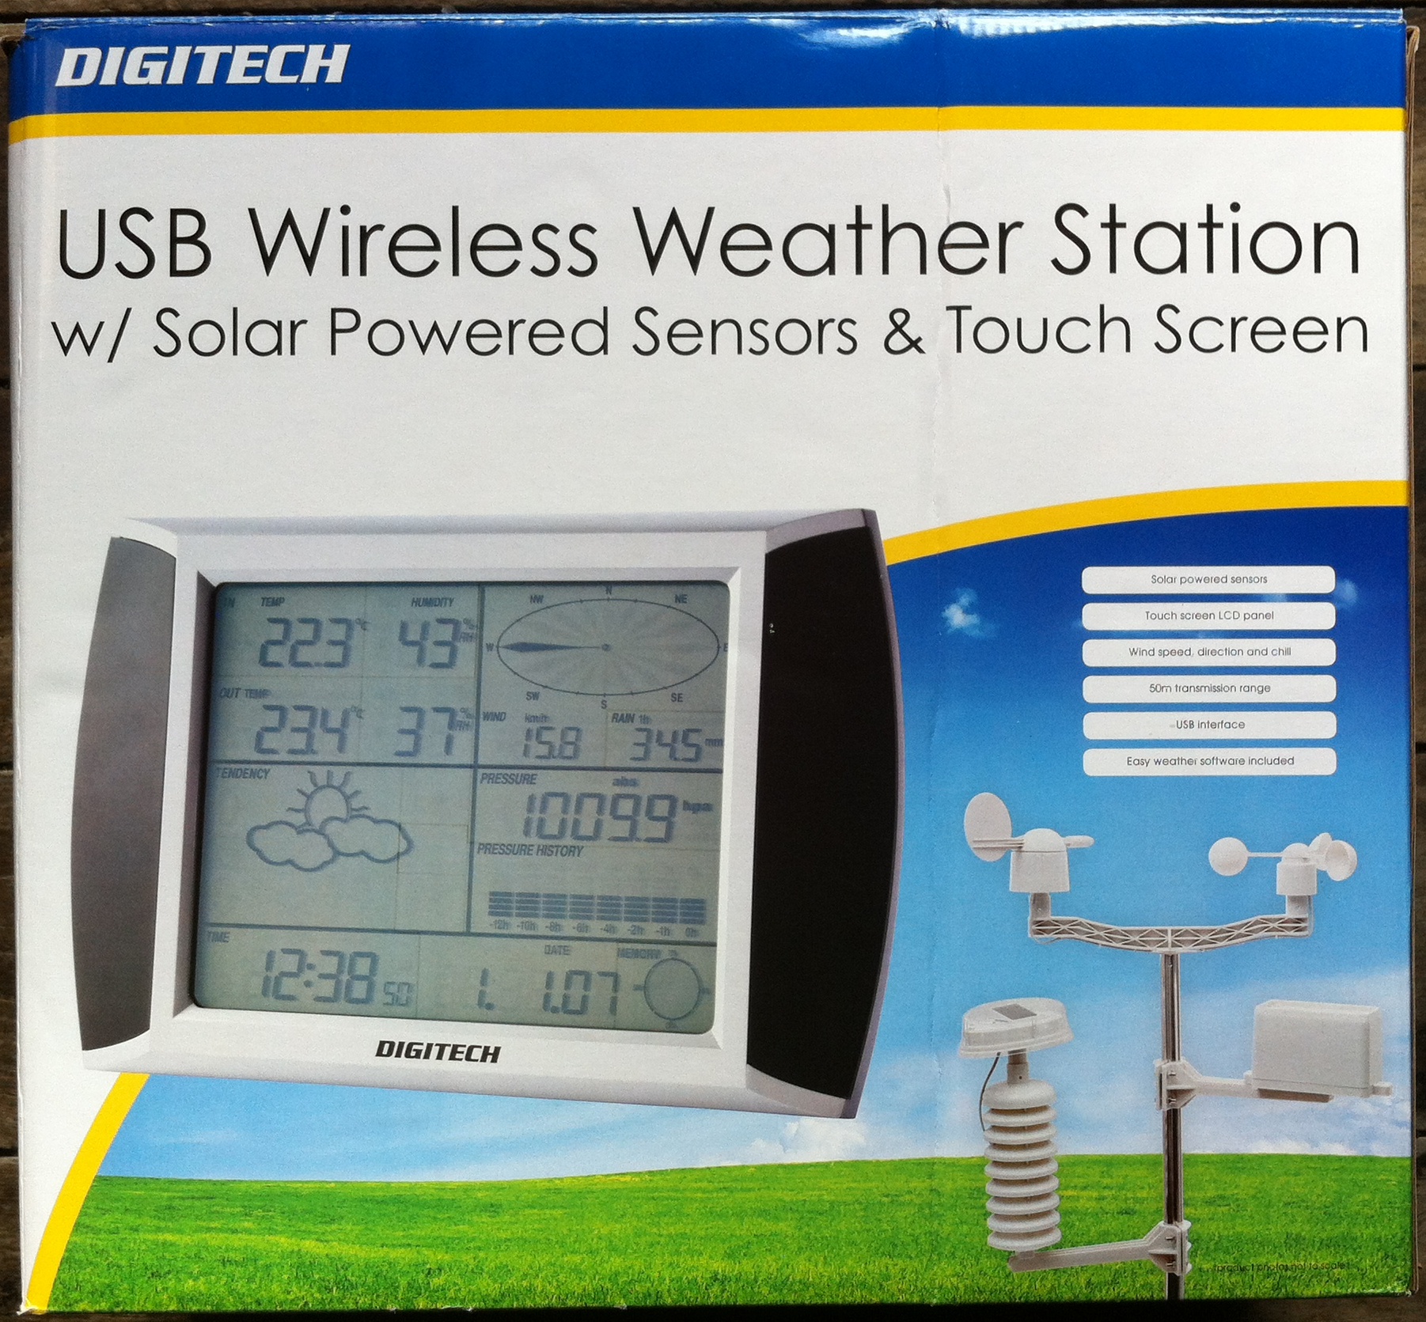
USB Wireless Weather Station

Slide 4
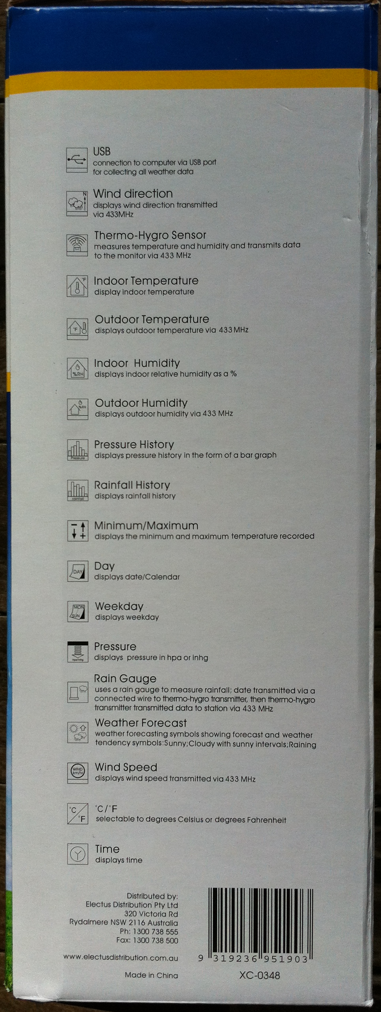
USB Wireless Weather Station
Wind direction
Wind speed
Temperature
Humidity
Cumulative rainfall
Absolute air pressure

Slide 5
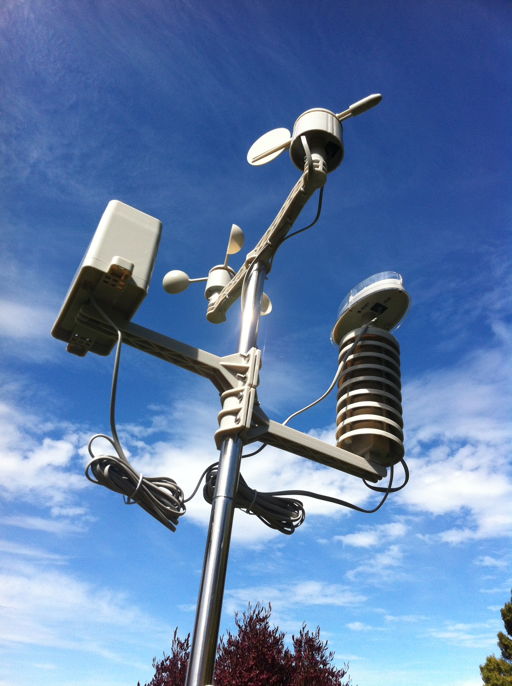
Remote Sensor
Vane
Pluviometer
Anemometer
Photovoltaic
Thermometer
Hygrometer
Transmitter

Slide 6
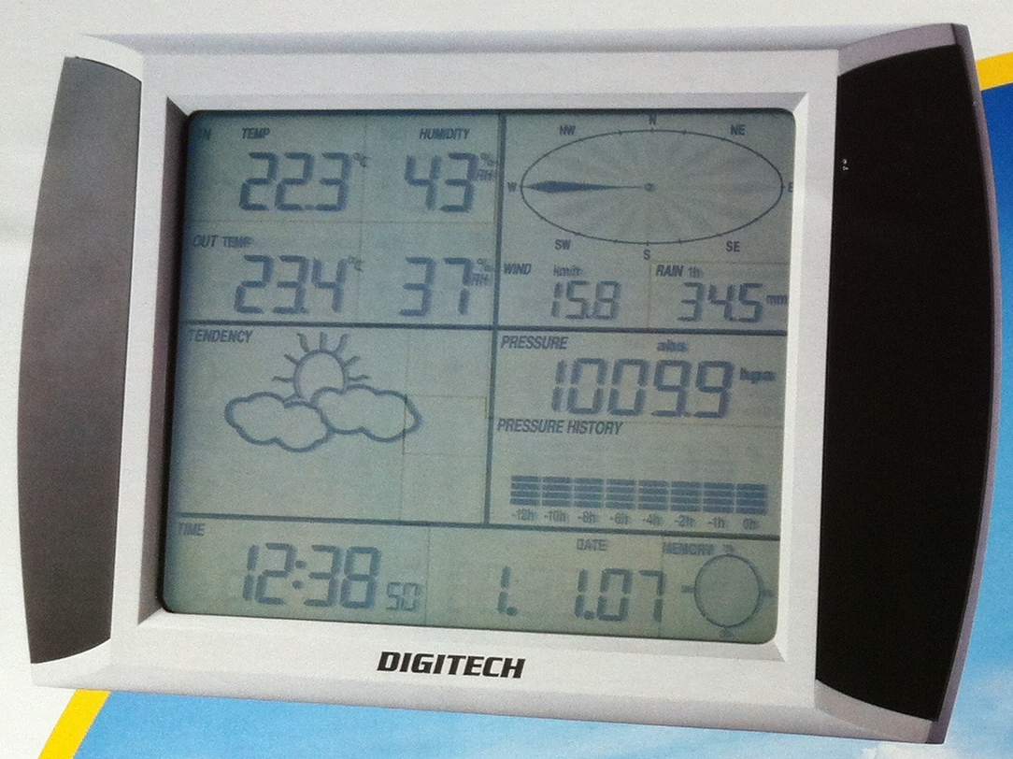
Base Unit
Inside temp / humidity
Wind direction
Outside temp / humidity
Wind speed
Rain
Guesswork
Air pressure
Guesswork
Current Time / Date
Memory usage

Slide 7
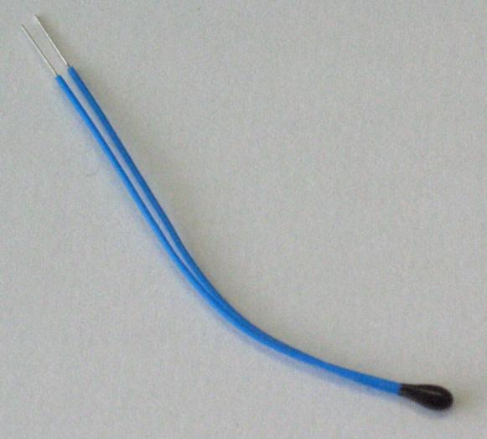
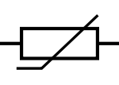
Temperature
Thermistor ( )
The relationship between resistance and temperature is (1st order) linear
ΔR=kΔT
k = temperature coefficient of resistance
If we know R at a given temperature, and we know k then we can solve for T.
The weather station is accurate to 0.1°C For more accuracy (0.02° over 200°C range) the Steinhart–Hart equation is used:
1/T = A+B ln(R)+C(ln(R))³
For more information on thermistors see http://en.wikipedia.org/wiki/Thermistor

